Slide 1
Focus Time
Team 14:
Felipe Flores
Tianyu Ma
Wen Li

Slide 2


The Problem
Has this ever happened to you?

Slide 3

The Problem
Oh but before that let me check on my phone!

Slide 4
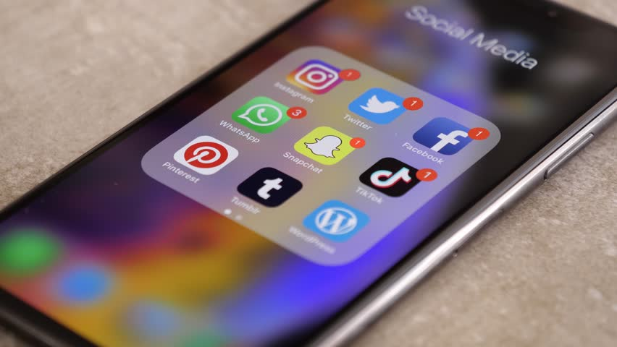
The Problem
Better check my texts, emails, etc…

Slide 5

The Problem
“It” Happens

Slide 6
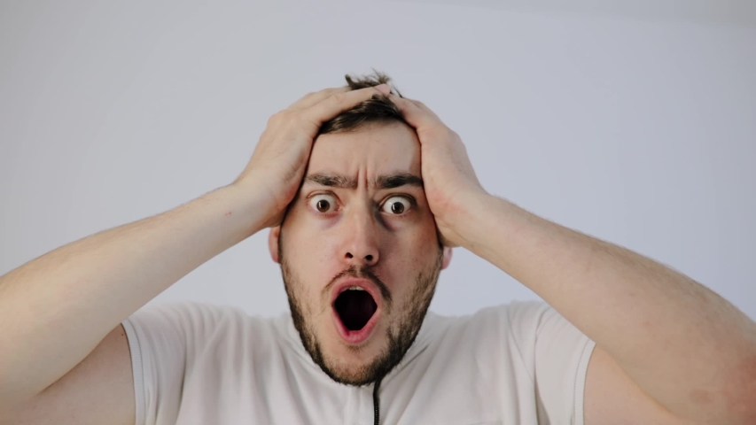
The Problem
Oh gosh diddly darn! Where did the time go?!

Slide 7
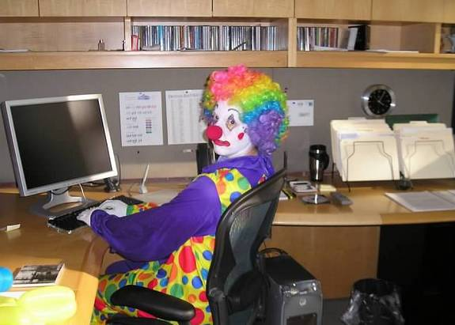
The Problem
“Hey (insert your name here) how goes your progress?”

Slide 8
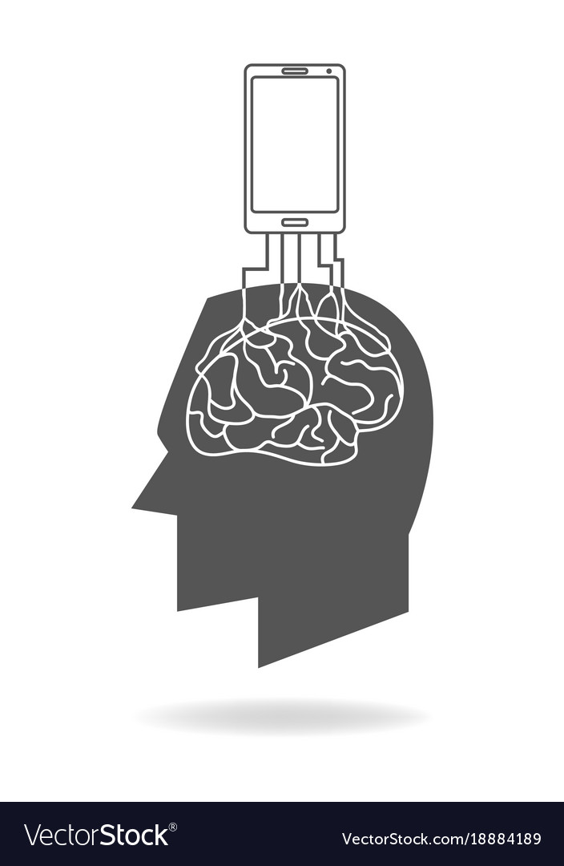
The Problem
84% of Teenage Americans own a smartphone – Common Sense Media
97% of Adult Americans own a smartphone now - PewResearch
Nearly half of people spend 5 to 6 hours on their smartphone daily - Statistica

Slide 9
Our Proposed Solution
Our “Focus Time” App!
The purpose of this project is to provide the design of a free to download mobile application for assisting the user in staying focused for long periods of time.
The primary goal of this application is to streamline several popular techniques used to stay focus all in one app!

Slide 10
Functional Requirements

Slide 11
Sign-Up and Logging In
Sign-Up: Requires an Account Name and Strong Password(mix of number, upper case, lower case, and symbols). Password will be required to type correctly twice to activate. Association with an email account is recommended.(Retrieving password and Sharing TimeSets relies on it)
Logging In: Once Signed up, users can log in through account name with password or account name with one-time code sent through email. Users can choose to make the device remember password.

Slide 12
Creating TimeSets
TimeSets can block distractions and aim to help users utilize/organize their time more efficiently.
It contains following settings: Title, Timer Duration, Blocking Strength, and Music options.
Title is the name of the TimeSet. Timer Duration and Blocking Btrength define how long the concentration time will last and how restrictive it is during such period. Music options allow the device to play music chosen by users.
Upon creation of TimeSets, users could specify above settings otherwise they will be set to default values.

Slide 13
Accessing TimeSets
Once users are logged in, they can access all TimeSets they created. TimeSets will be displayed on the screen in their timer’s order. Users can use search box or filter to find their desired TimeSets.
Once started, study/work time is initiated, and users will not be able to leave our app until they finish the session (heavy commitment).
The Timer will start counting down, during which notifications are blocked and a music player will appear for the user to listen to while they work.

Slide 14
Sharing TimeSets
Upon registration, if users have an email address associated with the account, then they can share TimeSets with their customized settings through email to anyone. Other users who receive the email can click the link inside it, then they will be asked and redirected to the app.
For users who do not have an email address associated with their account, they can share their TimeSets through Bluetooth to other users with the app.

Slide 15
Non-Functional Requirements

Slide 16
TimeSet Storage
Database must be able to support the storage place to allocate user data
Can be adjusted to wherever the user wants to on their device

Slide 17
TimeSet Data Encryption
If the data is private, it will be automatically encrypted in TimeSet
Users can also decide to encrypt any data they want for safety

Slide 18
Reset Passwords
Allows the user to reset their password if they forgot, or are having difficulties logging in
Enforces a rule for only accepting passwords with at least 8 characters
Notes:
Can be like the previous one if the user want to

Slide 19
Uptime of Application
TimeSet app must be down for thirty minutes each month for maintenance
User will be notified in advance for the maintenance time

Slide 20
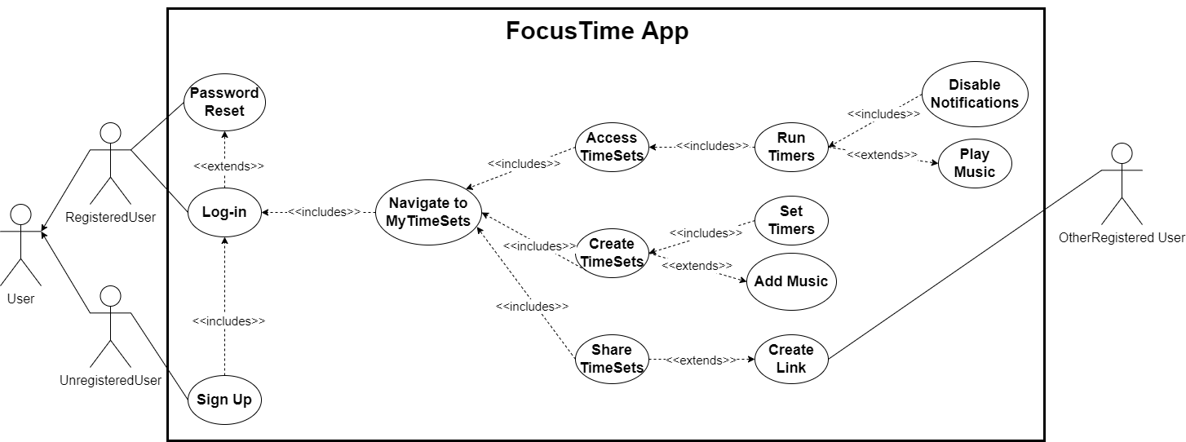
Use Case Diagram

Slide 21
System Constraints
Mobile Application Framework (Xamarin)
A Developing Language (C#)
Mobile Phone Platform (iPhone & Android)
Developer Expertise (Mobile Development Experience)
Time Constraints (End of Semester)

Slide 22
Evolutionary Requirements
“Focus Time” App coming to the Web!

Slide 23

Questions?

Slide 24
Citations
https://www.123rf.com/stock-photo/director_computer_user.html?sti=of87ladikjfki8jley|
https://wallhere.com/en/wallpaper/167791
https://www.shutterstock.com/video/clip-1028941868-eppelheim-baden-wurttemberg--germany---05
https://www.shutterstock.com/video/clip-1054407893-shocked-man-put-hands-on-head-very
https://gifer.com/en/B6Qs
https://www.independent.co.uk/life-style/health-and-families/mobile-phones-children-kids-a9308266.html
https://www.pewresearch.org/internet/fact-sheet/mobile/
https://www.statista.com/statistics/1224510/time-spent-per-day-on-smartphone-us/#:~:text=According%20to%20a%20survey%20conducted,average%20on%20their%20phone%20daily.
https://www.vectorstock.com/royalty-free-vector/smart-phone-rooted-in-the-human-brain-vector-18884189

